Slide 1

Kinect Slider
Demo
By
Claton Hendricks
Kinect Slider

Slide 2
Controlling PowerPoint presentations using Kinect Slider is intuitive
Using
Hand Gestures
Voice Commands
Or Use Both
Kinect Slider

Slide 3
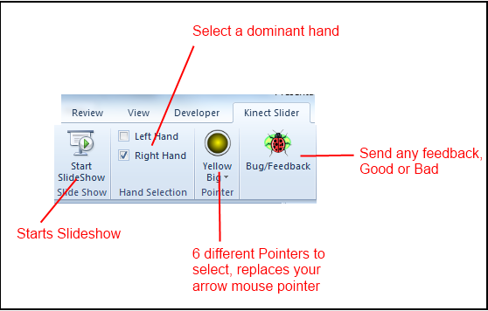
After a successful installation you should have a new Ribbon in PowerPoint “Kinect Slider
Kinect Slider

Slide 4

Next Slide
Hand Gestures
Swipe your Hand from Right to Left of the screen
Swipe your Hand from Left to Right of the screen
Previous Slide
Kinect Slider

Slide 5
Voice commands
Next Slide/Animation:
Previous Slide/ Animation:
End the presentation:
Next
Previous
Close, End, Exit
Or you could just use the ESC key
Kinect Slider

Slide 6
What Next??
Allowing the user to customize Hand gestures
Add your list of words to control the presentation (Next, Previous etc.).
Add your own custom cursors.
Kinect Slider

Slide 7
Thank You!
Kinect Slider

